Slide 1

Customer Churn
Final Project

Slide 2



Meet Our Team :
Doha Ahmad Hafez
Aml Waleed Farouq
Yara Mostafa Elmeligy
Lubna Ahmad Lasheen
Ramy Magdy Mehanna
Mohamed Essameldin
T E A M
Our Instructor :
Eng. Kareem Ahmad

Slide 3




Content :
01
03
Machine Learning
Introduction
02
Dashboard
04
Deployment

Slide 4

1
Introduction

Slide 5

What Is Customer Churn ?

Slide 6


Customer Churn :
It is defined as when customers or subscribers discontinue doing business with a firm or service.

Slide 7
Why Customer Churn :
In the telecom industry,
customer churn rates range from 15-25% annually
due to fierce competition among service providers.
Identifying and retaining high-risk customers before they switch
providers is crucial for profitability and growth.

Slide 8
Five churn scenarios and their solutions:
Tariff Plan Churn: Customers downgrade plans; offer flexible pricing and incentives to maintain ARPU.​
​
Service Churn: Customers cancel value-added services; improve quality and offer bundled discounts.​
​
Product Churn: Customers switch between prepaid/postpaid; allow seamless transitions with targeted offers.​
​
Usage Churn: Minimal usage indicates potential churn; monitor engagement and re-engage with personalized offers.​
​
Subscriber Churn: Customers fully leave the service; apply strong retention strategies and offer win-back incentives.​
Subscriber Churn
Tariff plan Churn
Service Churn
Product Churn
Usage Churn

Slide 9
Decision cycle of a subscriber :
01
Inert Subscriber
05
Conditional Churner
Unconditionally Loyal
Subscriber
02
06
Lifestyle Migrator
03
Locked-In Subscriber
07
Unsatisfied Churner
04
Conditionally Loyal
Subscriber

Slide 10
Decision cycle of a subscriber :
1. Inert Subscriber: Weak loyalty; simplify processes and offer incentives to retain them.
2.Unconditionally Loyal Subscriber: Highly satisfied; maintain quality and offer loyalty rewards.
3.Locked-In Subscriber: Stays due to contract; improve experience and offer renewals before contract ends.
4.Conditionally Loyal Subscriber: Weak loyalty; provide flexible plans and personalized retention offers.
5.Conditional Churner: High churn risk; Give special deals and Make your service better.
6.Lifestyle Migrator: Needs have changed; Give moving offers and Make the network stronger.
7.Unsatisfied Churner: Dissatisfied and leaving; engage them, Make improvements and Offer special deals

Slide 11
Data Overview:
This dataset, titled ‘Telco Customer Churn’
contains information on 7,043 customers, The dataset comprises 21 columns:
Customer ID: Unique identifier for customers.
Demographics: Gender, Senior Citizen, Partner, and Dependents.
Service-related: PhoneService, MultipleLines, InternetService, OnlineSecurity, OnlineBackup, DeviceProtection, TechSupport, StreamingTV, and StreamingMovies.
Contract and Billing: Contract type, PaperlessBilling, PaymentMethod, MonthlyCharges, and TotalCharges.
Churn: binary feature indicating if the customer has churned (Yes) or not (No).

Slide 12
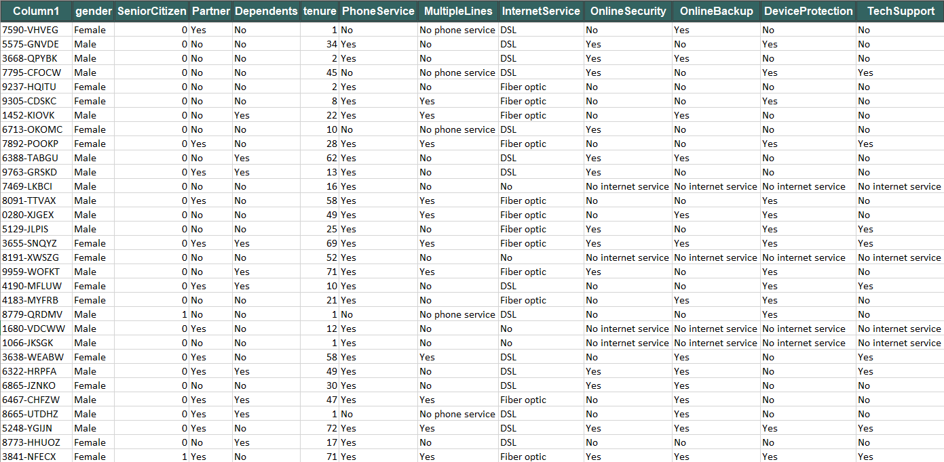
Customer Churn Table:

Slide 13
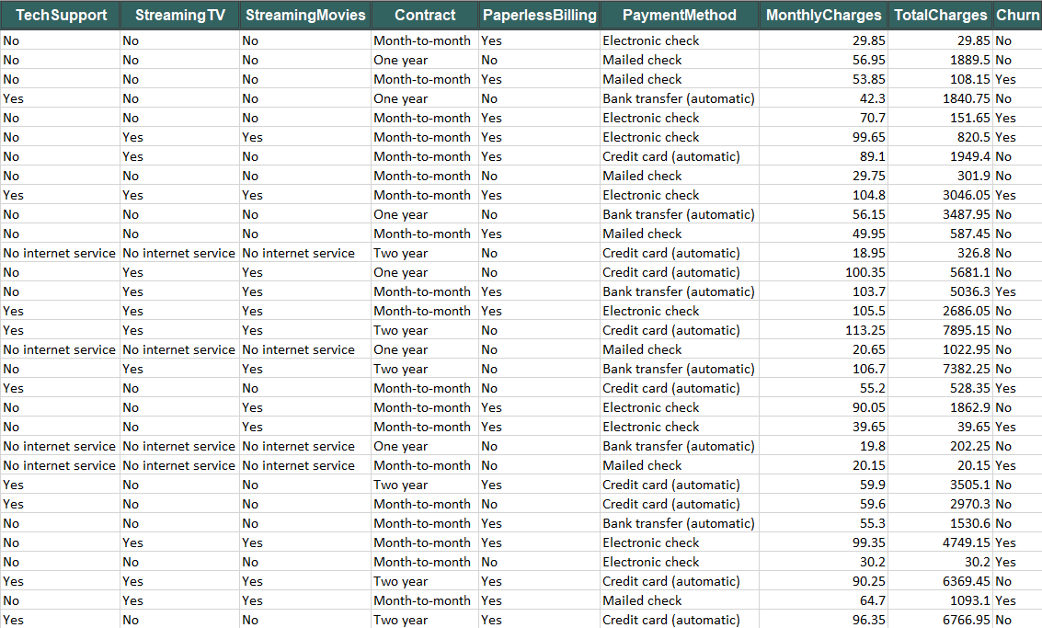
Customer Churn Table:

Slide 14


Dataset :
IBM Dataset
Dataset Link

Slide 15
Meta Dataset :
Column Name | Data type | Description | Possible Values
Customer ID | String | Unique identifier for each customer | 9305-CDSKC / 7590-VHVEG
Gender | Categorical (String) | Gender of the customer | Male / Female
Senior Citizen | Integer (Binary) | Binary indicator of whether the customer is a senior citizen | 0: Not a senior citizen 1: Senior citizen
Partner | Categorical (String) | Indicates if the customer has a partner | "Yes", "No"
Dependence | Categorical (String) | Indicates if the customer has dependents. | "Yes", "No"
Tenure | Integer | Number of months the customer has been with the company. | 27 / 49 / ......... Number of Months
Phone Service | Categorical (String) | Whether the customer has phone service | "Yes", "No"
Multiple Lines | Categorical (String) | Whether the customer has multiple phone lines | "Yes", "No", "No phone service"
Internet Service | Categorical (String) | Type of internet service subscribed to by the customer | "DSL", "Fiber optic", "No"
Online Security | Categorical (String) | Indicates if the customer has online security services. | "Yes", "No", "No internet service"
Online Backup | Categorical (String) | Indicates if the customer has online backup services | "Yes", "No", "No internet service"

Slide 16
Meta Dataset :
Column Name | Data type | Description | Possible Values
Device Protection | Categorical (String) | Indicates if the customer has device protection services. | "Yes", "No", "No internet service"
Tech Support | Categorical (String) | Indicates if the customer has tech support services. | "Yes", "No", "No internet service"
Streaming TV | Categorical (String) | Indicates if the customer subscribes to streaming TV services | "Yes", "No", "No internet service"
Streaming Movies | Categorical (String) | Indicates if the customer subscribes to streaming movie services. | "Yes", "No", "No internet service"
Contract | Categorical (String) | Type of customer contract. | "Month-to-month", "One year", "Two year"
Paperless Billing | Categorical (String) | Indicates if the customer is on paperless | "Yes", "No"
Payment Method | Categorical (String) | The method used by the customer to make payments. | "Electronic check", "Mailed check", "Bank transfer (automatic)", "Credit card (automatic)"
Monthly Charges | Float (Numeric) | The monthly charges for the customer’s services. | 53.85 / 49.95
Total Charges | Float (Numeric) | Total amount charged to the customer. | 151.65 / 6766.95
Churn | Integer (Binary) | Indicates whether the customer has churned (left the service). | 0: Did not churn1: Churned

Slide 17

Data Preprocessing (Data Quality):
Stage 4
We apply encoding On String Columns
Stage 2
Stage 3
Our Data doesn’t have Nulls Or Duplicate Values
Our Data doesn’t have any Outliers Value
Stage 1
We Upload Our Data

Slide 18
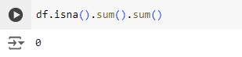
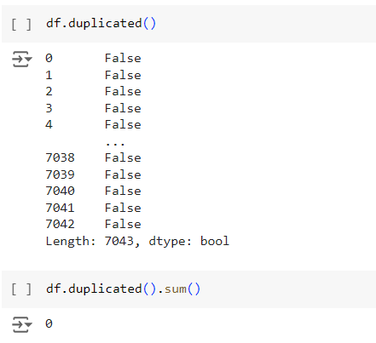
Data Preprocessing:
No Null Or Duplicate Values

Slide 19
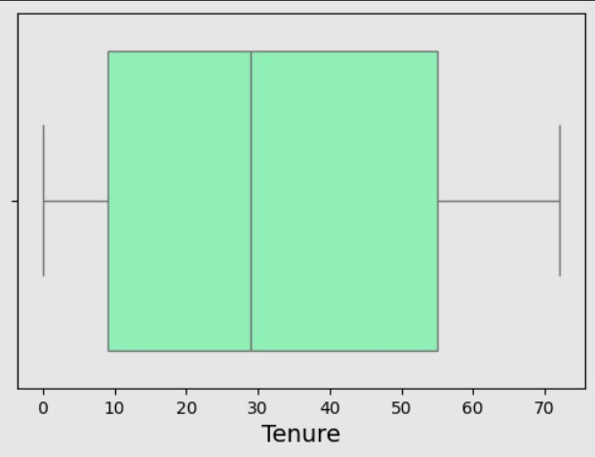
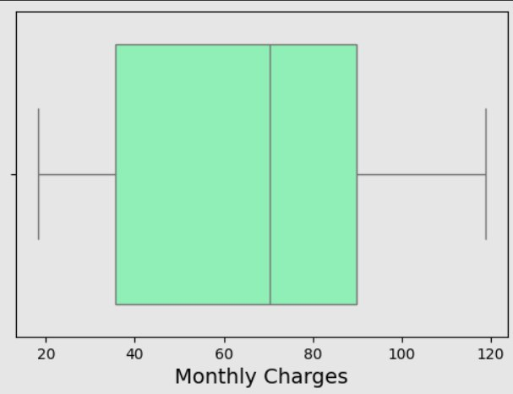
Data Preprocessing:
No Outliers in Our Numerical Data

Slide 20
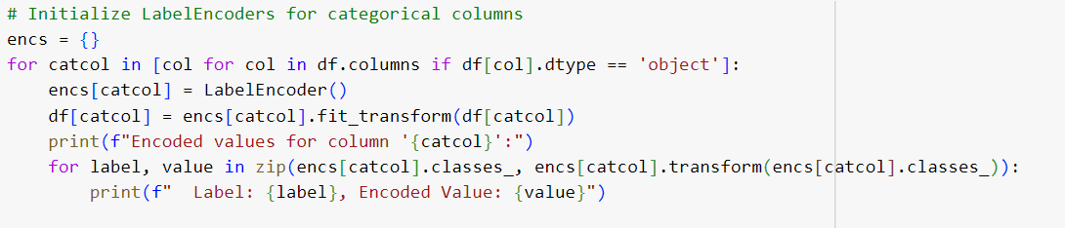
Data Preprocessing:
We Applied This Function To Encode All String Columns

Slide 21
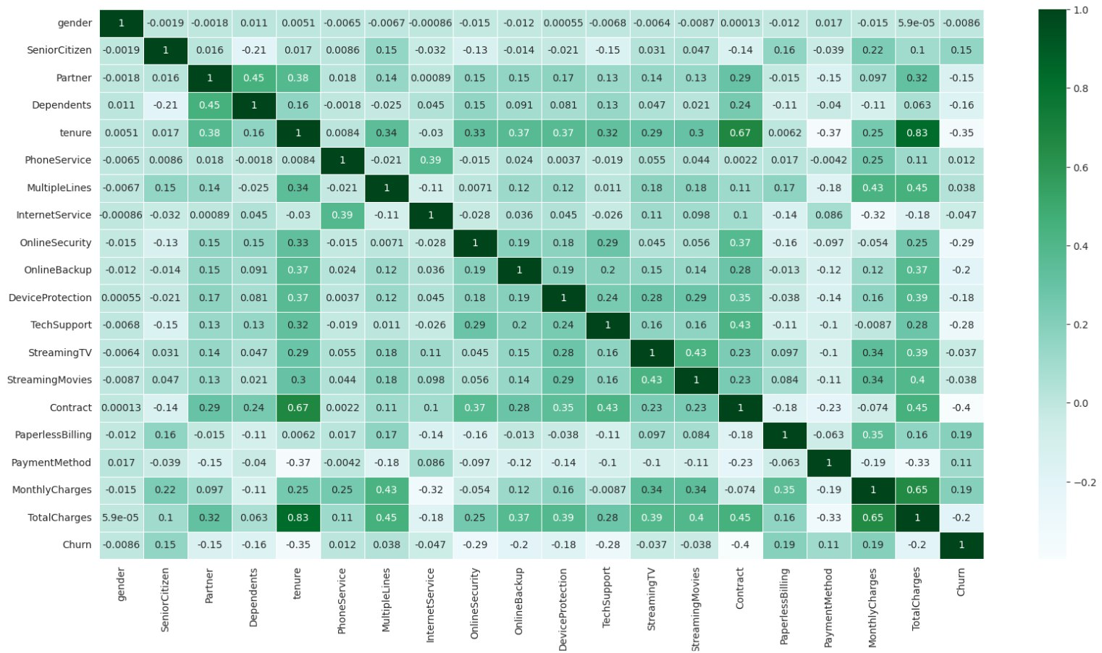
Data Correlation:

Slide 22
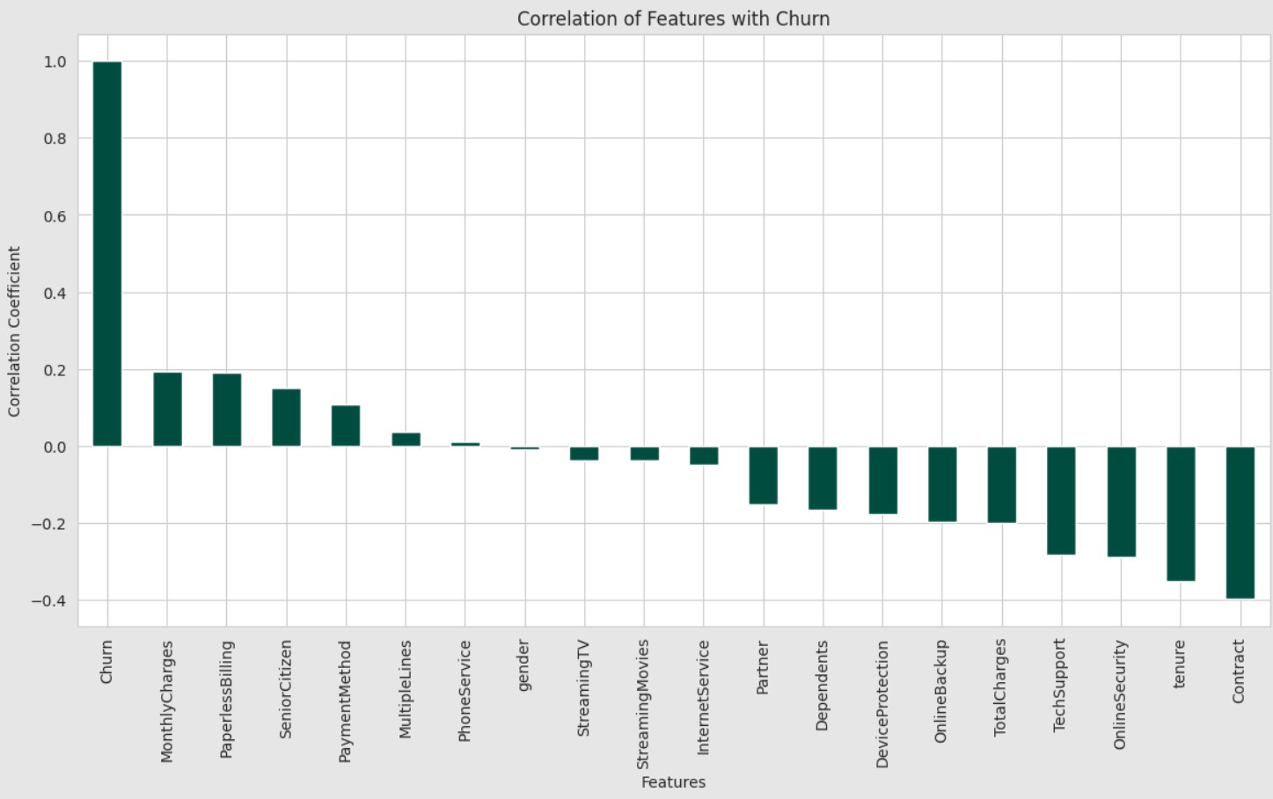
Data Correlation:

Slide 23

2
Dashboard

Slide 24
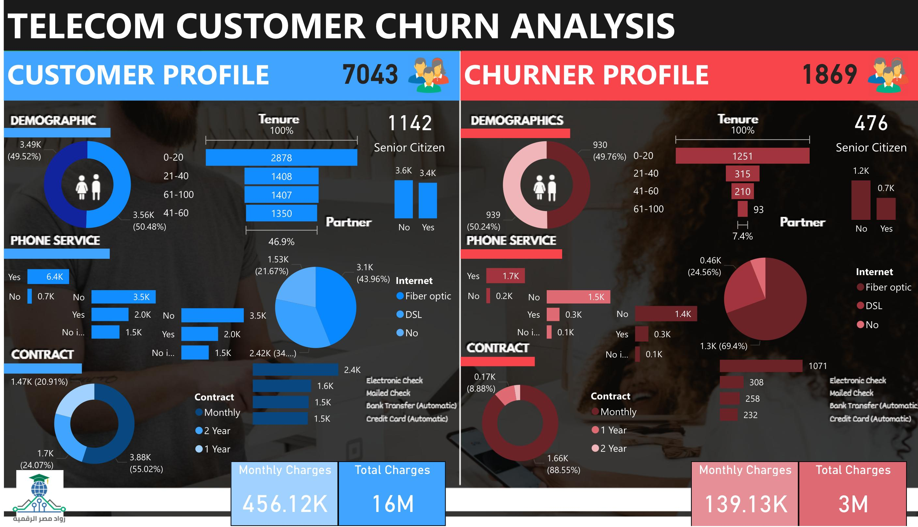

Slide 25
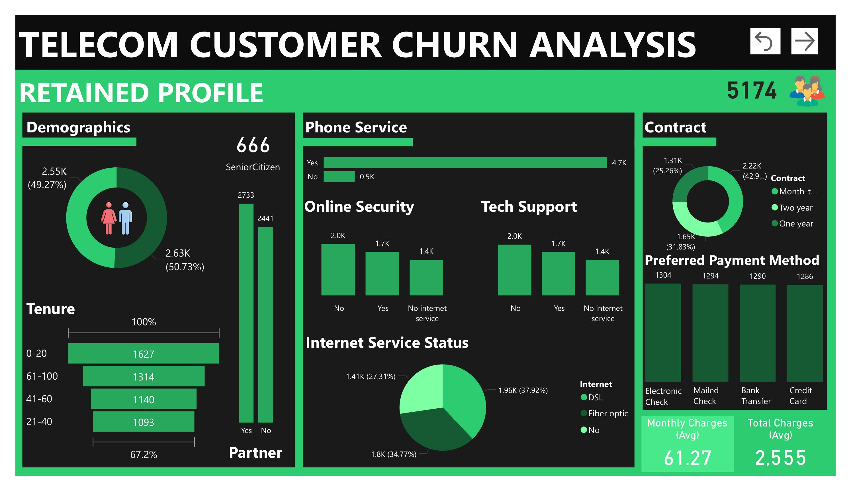

Slide 26
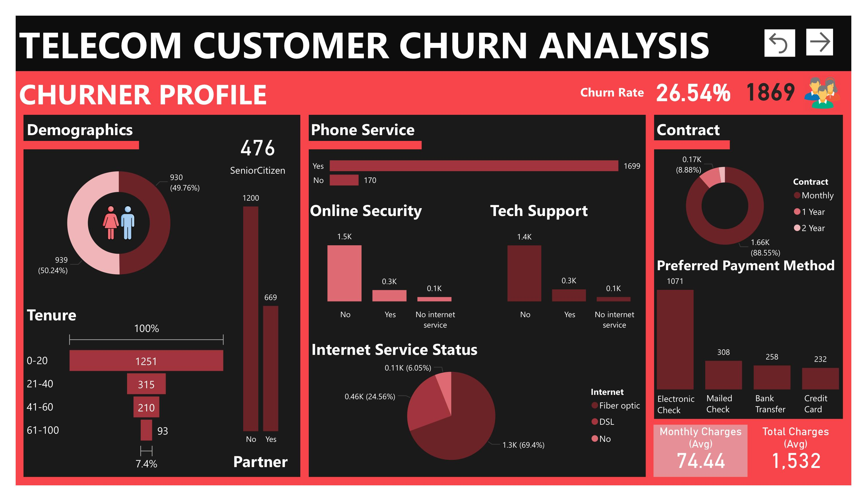

Slide 27
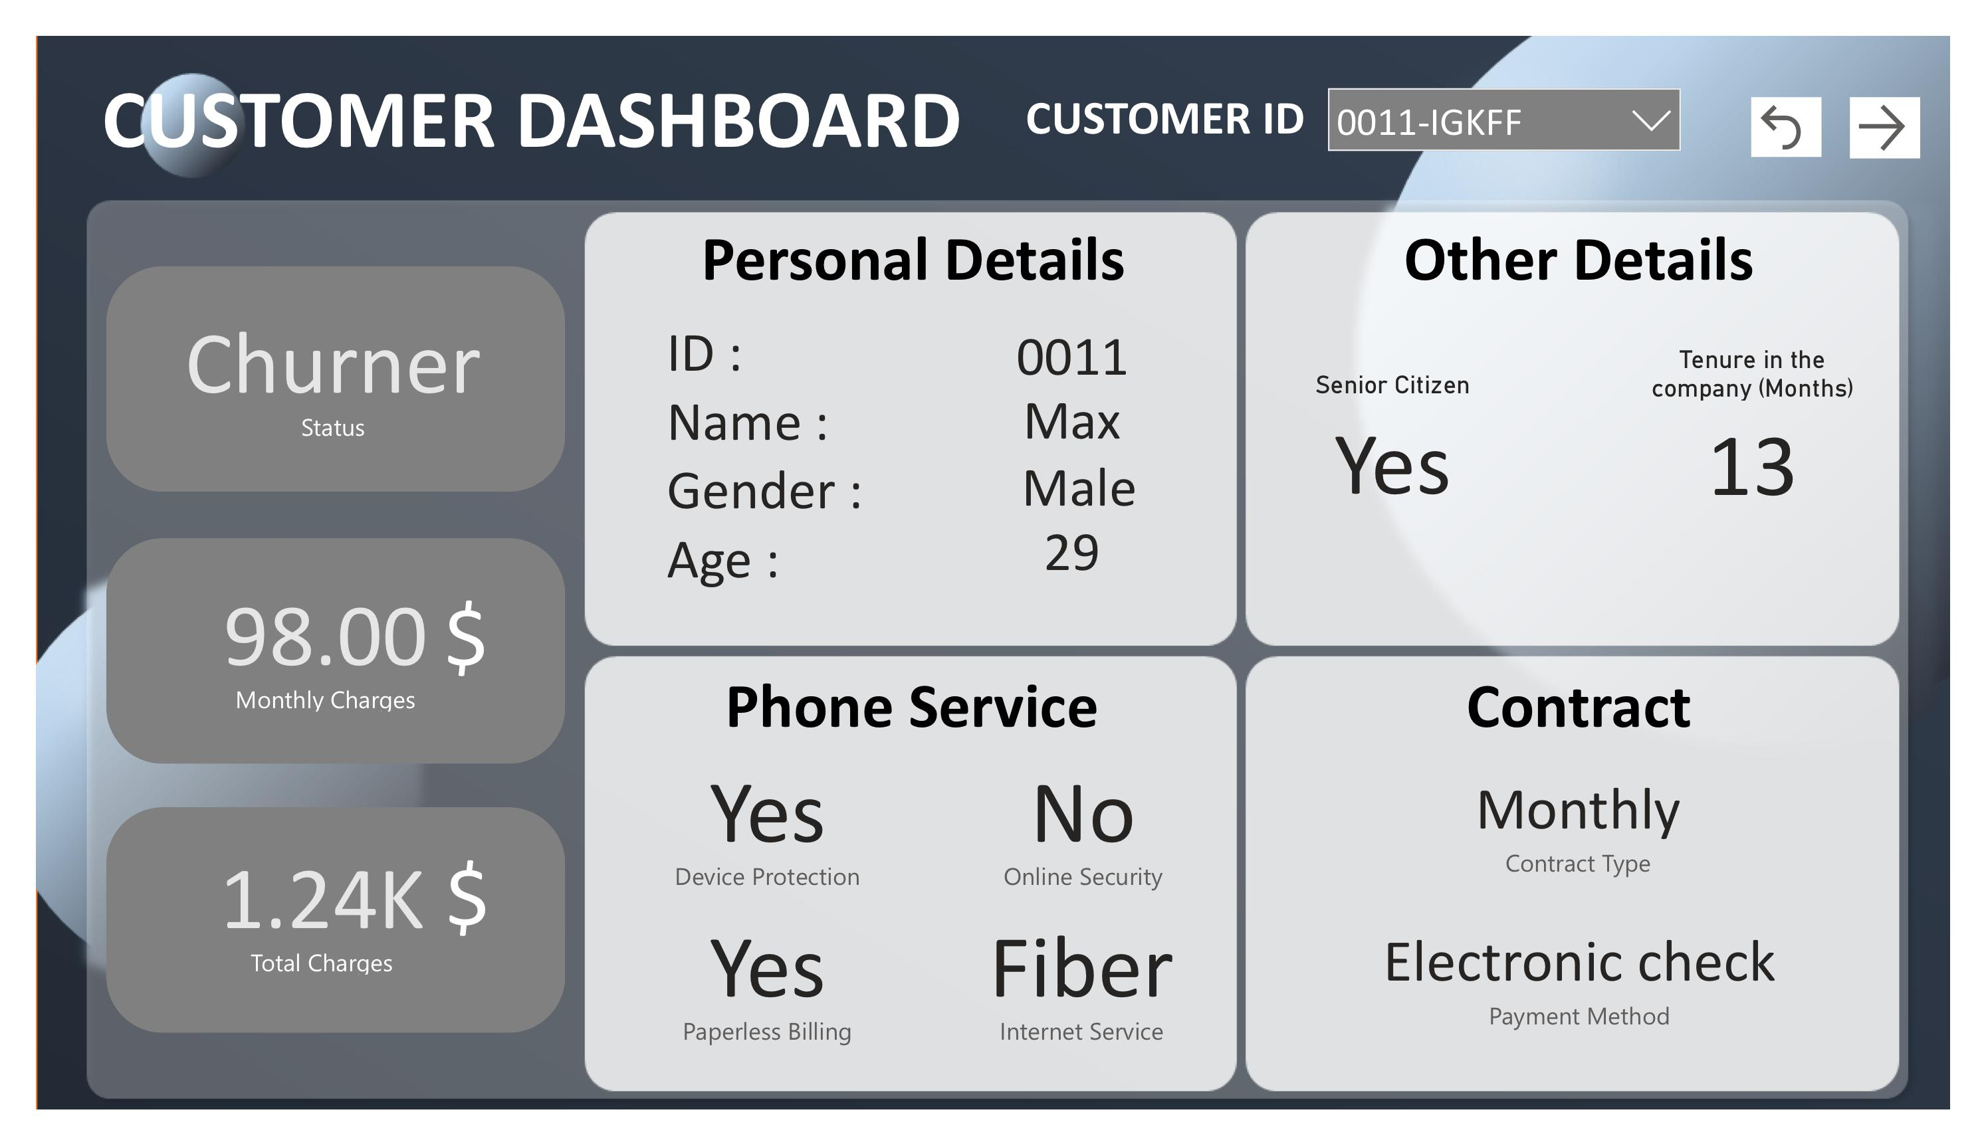

Slide 28
Insights:
Contract Length Impact: 88.5% of churned customers had monthly contracts, indicating a strong link between short-term contracts and higher churn rates.
Tenure and Churn Risk:67% of churned customers left within 20 months, showing churn occurs early in the customer lifecycle.
Senior Citizens: While only 12.9% of retained customers are seniors, they make up 25.5% of churned customers, suggesting a higher churn risk for this demographic.

Slide 29
Insights:
.Online Security and Tech Support: 78.1% of churned customers lacked Online Security, and 77.4% did not use Tech Support.
Internet Service Dissatisfaction: Fiber optic users had a higher churn rate (69.4%) than DSL or no-internet users, possibly due to dissatisfaction or pricing.
Higher Charges: Churned customers paid higher monthly charges ($74.44) compared to retained customers ($61.27), indicating pricing may drive churn.

Slide 30
Recommendations:
Strengthen Customer Retention for Short-Term Contracts: Offer discounts or loyalty rewards for switching from monthly to longer-term contracts, and highlight these benefits in marketing.
Target Early-Tenure Customers: Improve onboarding with regular check-ins and personalized communication to build loyalty in the early months.
Reduce Senior Citizen Churn: Develop targeted marketing and simplified service packages for seniors to boost engagement and retention.

Slide 31
Recommendations:
Enhance Online Security and Tech Support Services: Actively promote Online Security and Tech Support, bundling them with core services to enhance loyalty.
Address Fiber Optic Service Issues: Analyze customer feedback to improve fiber optic services and consider promotional rates to attract customers.
Lower Monthly Charges: Reassess pricing strategies, offering flexible options or discounts for at-risk customers while highlighting service value.

Slide 32

3
Machine Learning

Slide 33





Split the data into:
Training set
Validation set
Test set
Used Grid search
Measuring the
Models accuracy
01
03
05
Data preparation
Splitting
Hyper parameter tuning
And evaluation
Model selection
prediction
02
04
Feature selection
Feature encoding
Data shuffling
Random forest classifier
Logistic regression
Support vector machine
Make predictions
Save the model

Slide 34
Data Preparation:
Feature selection :We measured the relationship between each feature and customer churn using techniques like Correlation Analysis to detect linear relationships with numerical features
Feature encoding : We encoded categorical features into numerical representations, improving model compatibility and allowing us to better analyze their relationship with customer churn for more accurate predictions
Data shuffling :We shuffled the data before splitting it into training, validation, and testing sets to randomize distribution, avoiding bias and ensuring each set was representative for better model generalization

Slide 35
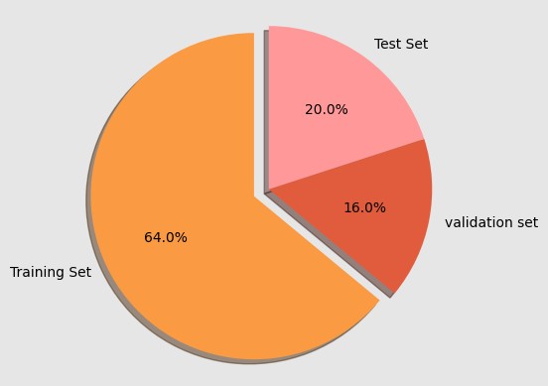
Splitting the data
We split the data into features and target, then performed an 80/20 train-test split. Additionally, we further split the training set, using 80% for training and 20% for validation, to fine-tune each model and improve performance during evaluation
Train set size (4507,20)
Validation set size (1127,20)
Test set size (1409,20)

Slide 36
Model selection
We evaluated three different algorithms:
Random forest classifier
Logistic regression
Support vector machine

Slide 37
Hyper parameter tuning And evaluation
The steps involve :
Hyperparameter tuning using GridSearchCV
model evaluation on validation and test sets.

Slide 38
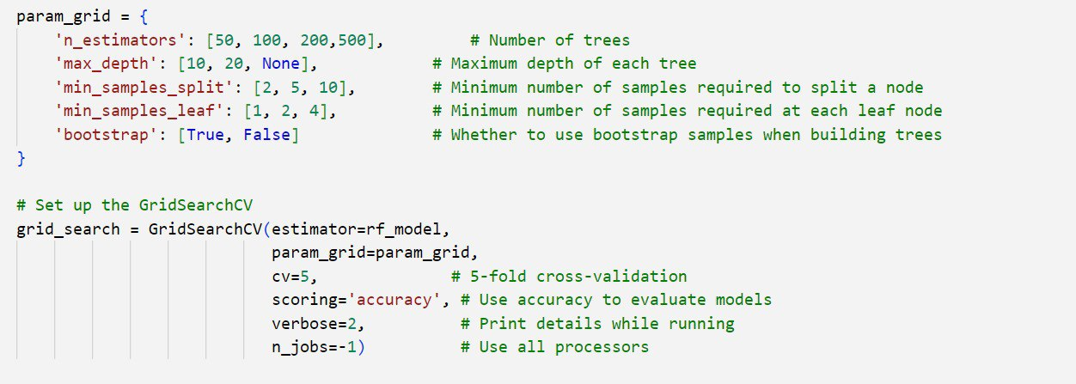
Key parameters for RF model
We employed techniques like grid search to identify the optimal hyperparameters for this dataset.

Slide 39
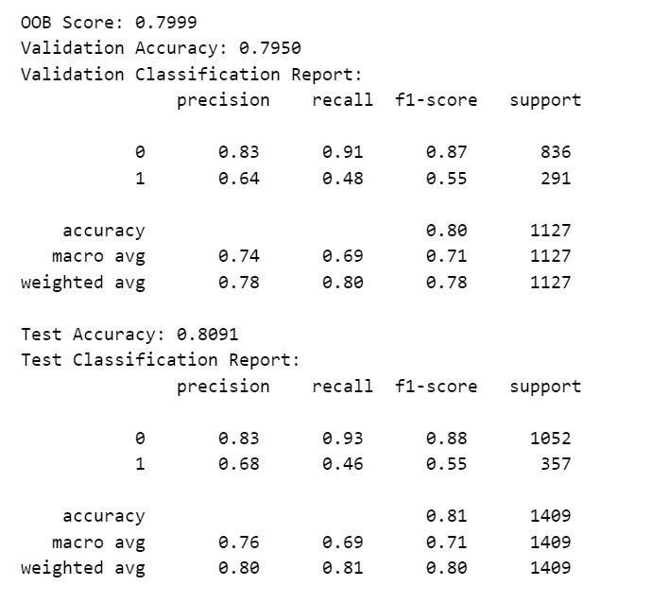
Model Evaluation
Evaluation Metrics:
Validation Accuracy.
Test Accuracy.
Classification reports (precision, recall, F1-score) for both validation and test sets.
Key Findings:
Validation accuracy: 79.5%.
Test accuracy: 80.91%.

Slide 40
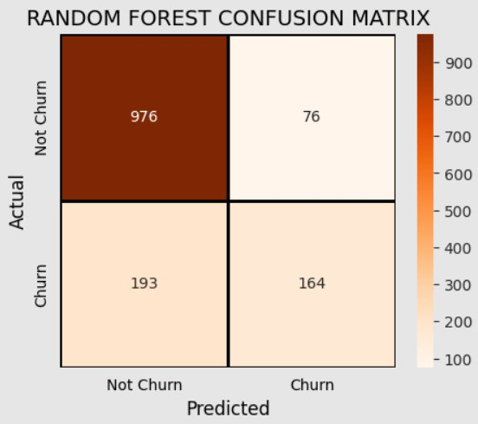
Confusion matrix

Slide 41
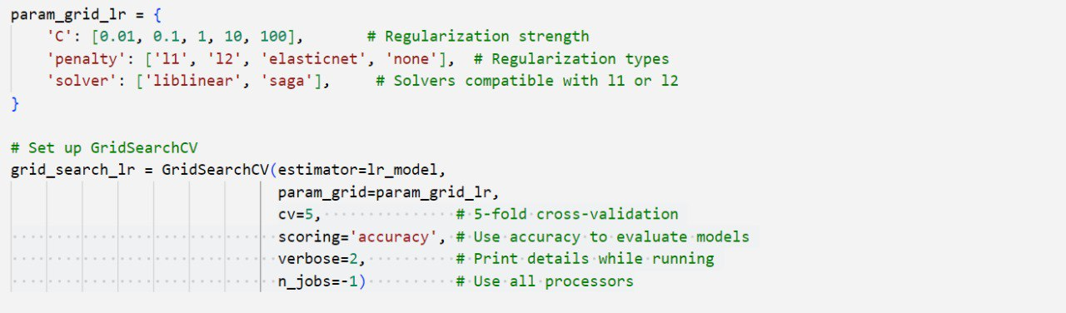
Key parameters for LR model
We employed techniques like grid search to identify the optimal hyperparameters for this dataset.

Slide 42
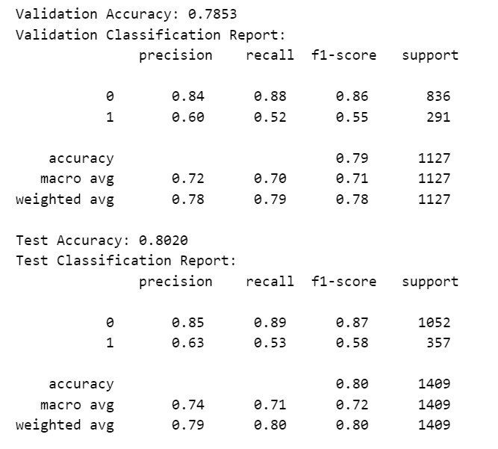
Model Evaluation
Evaluation Metrics:
Validation Accuracy.
Test Accuracy.
Classification reports (precision, recall, F1-score) for both validation and test sets.
Key Findings:
Validation accuracy: 78.5%.
Test accuracy: 80.2%.

Slide 43
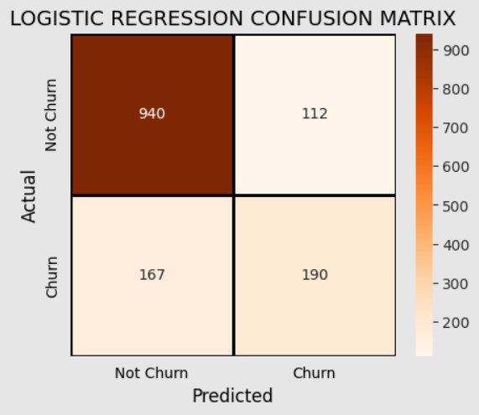
Confusion matrix

Slide 44
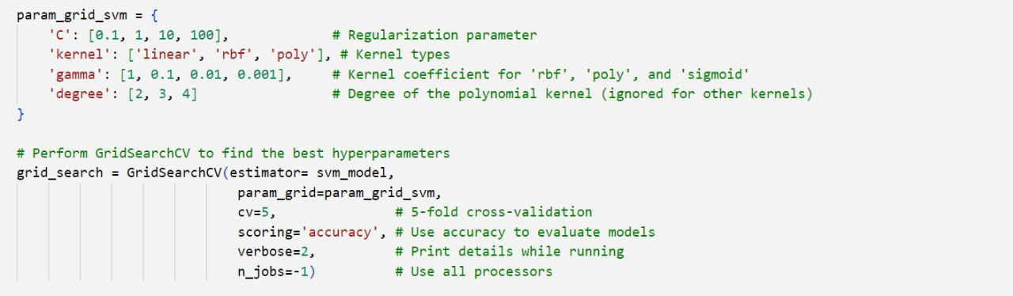
Key parameters for SVM model
We employed techniques like grid search to identify the optimal hyperparameters for this dataset.

Slide 45
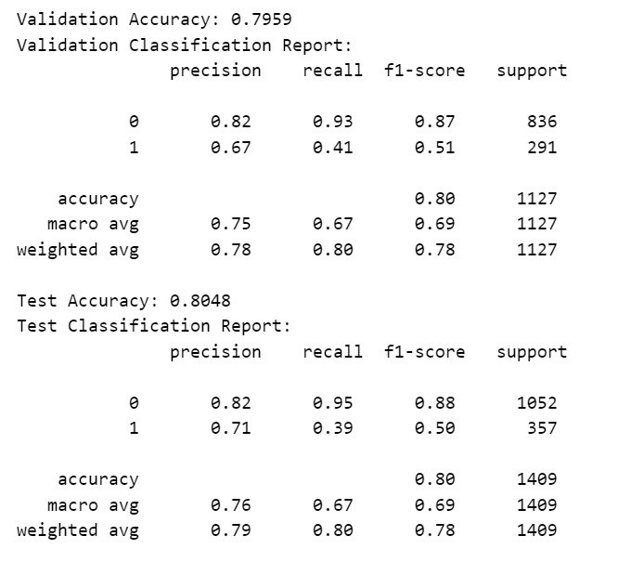
Model Evaluation
Evaluation Metrics:
Validation Accuracy.
Test Accuracy.
Classification reports (precision, recall, F1-score) for both validation and test sets.
Key Findings:
Validation accuracy: 79.6%.
Test accuracy: 80.5%.

Slide 46
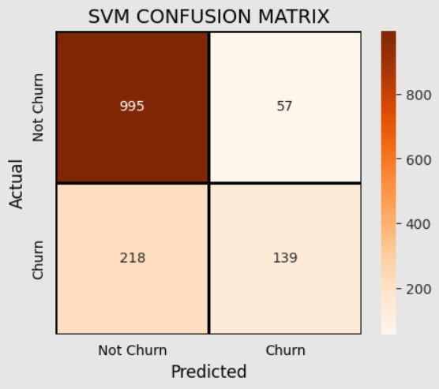
Confusion matrix

Slide 47
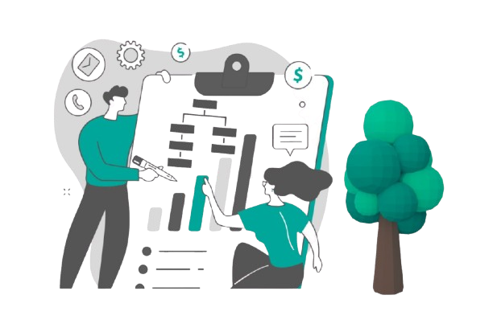
Best Model
Random forest classifier was chosen as the final model based on performance metrics with accuracy 80.91%
We will use this model in deployment to predict whether the customer will churn or not .

Slide 48
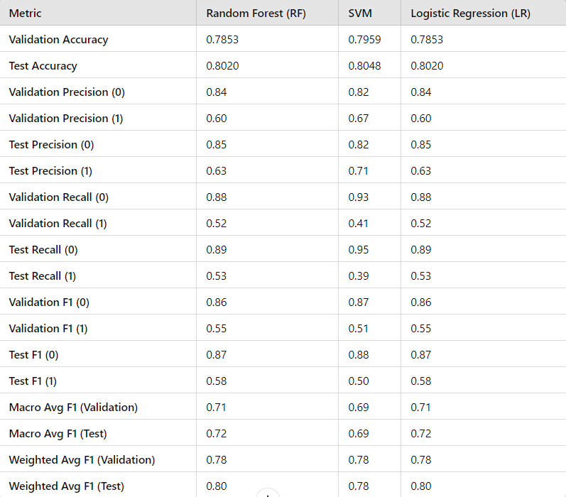
Models' comparison on different metrics

Slide 49
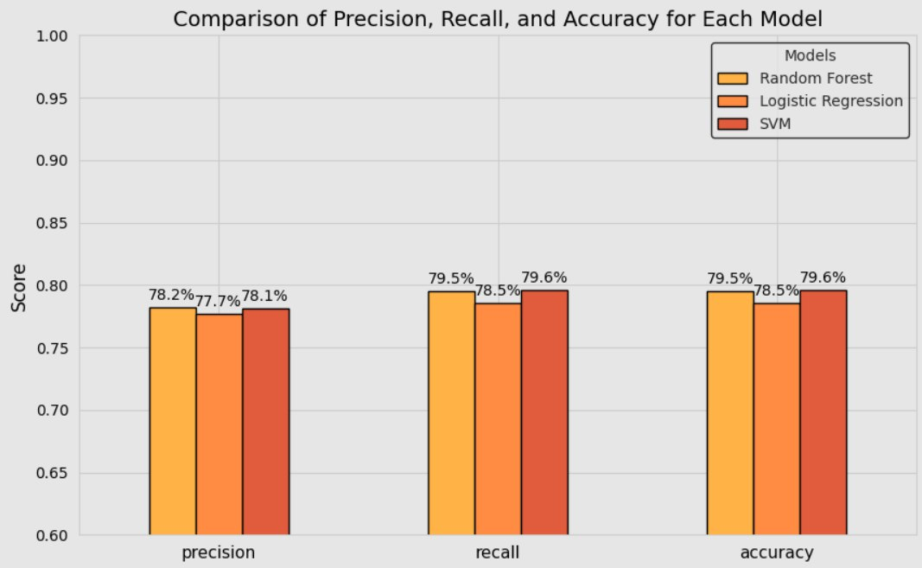
Models' comparison on validation set

Slide 50
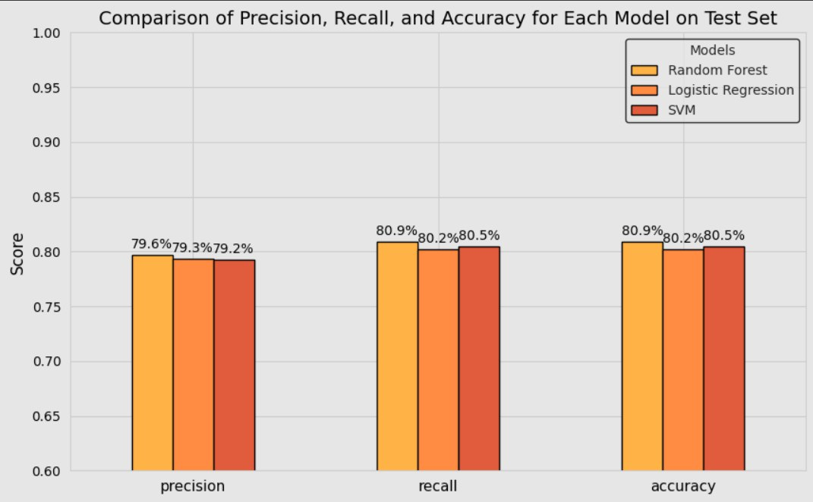
Models' comparison on test set

Slide 51

4
Deployment

Slide 52
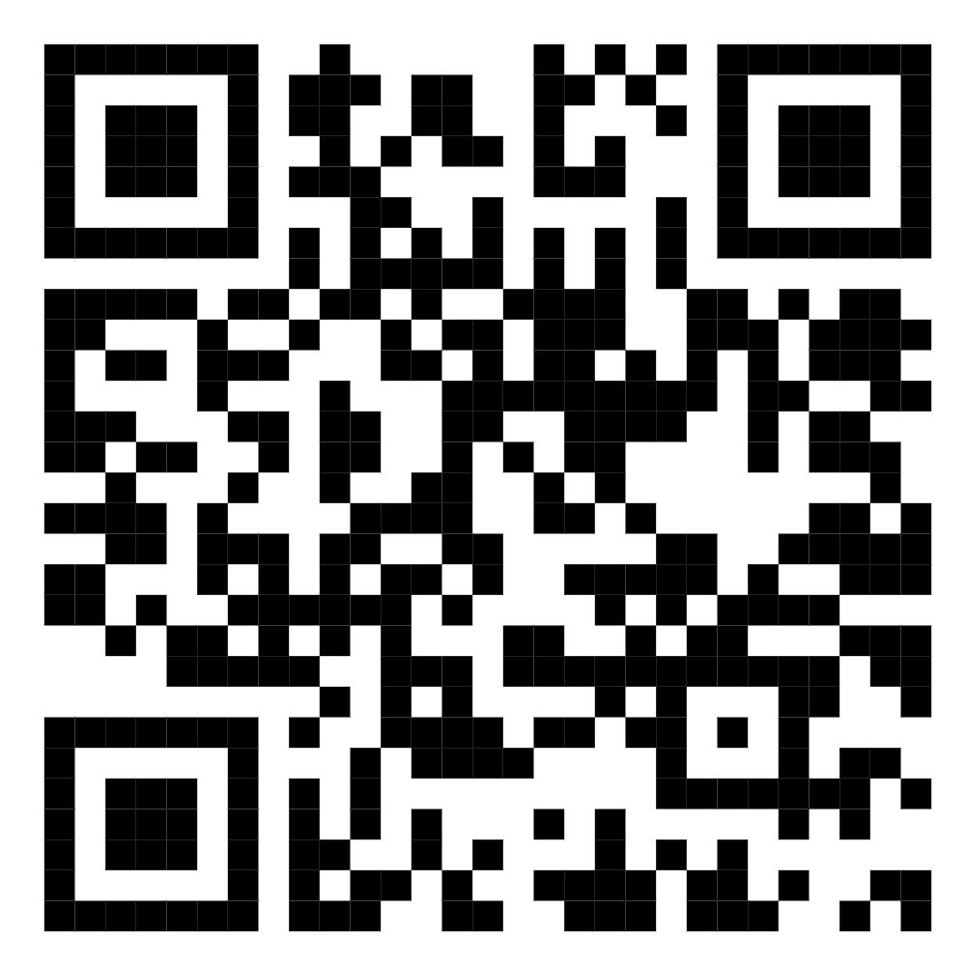
Deployment
https://huggingface.co/spaces/Ramy5200/big_project

Slide 53
Customer retention strategies:
Personalized Communication: Tailor messages and promotions to individual customer preferences to enhance their experience and make them feel valued.
Excellent Customer Service: Provide quick, knowledgeable support to build trust and encourage loyalty.
Feedback Mechanisms: Actively seek customer feedback to identify improvement areas and show that their opinions matter.

Slide 54
Customer retention strategies:
Exclusive Offers: Provide special promotions and discounts to existing customers to make them feel appreciated.
Exit Interviews: Gather insights from customers who leave to identify and address potential issues.
Referral Programs: Encourage satisfied customers to refer others by offering rewards for successful referrals, keeping existing customers engaged.

Slide 55

Any Questions ?

Slide 56
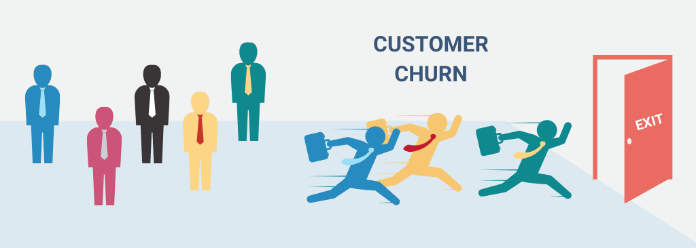
Thank you

